Slide 1



Swaasthya
By Group-6:
20BCE7067 MADHYAM PATRA
20BCE7062 NIRDESH SINGH
20BCE7066 GNANENDRA AJITHNAG GADDE
Professor:
SRINIVAS RAO BATTULA

Slide 2
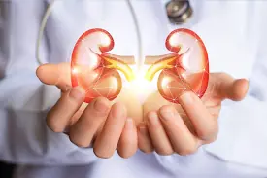
Chronic Kidney Disease

Slide 3
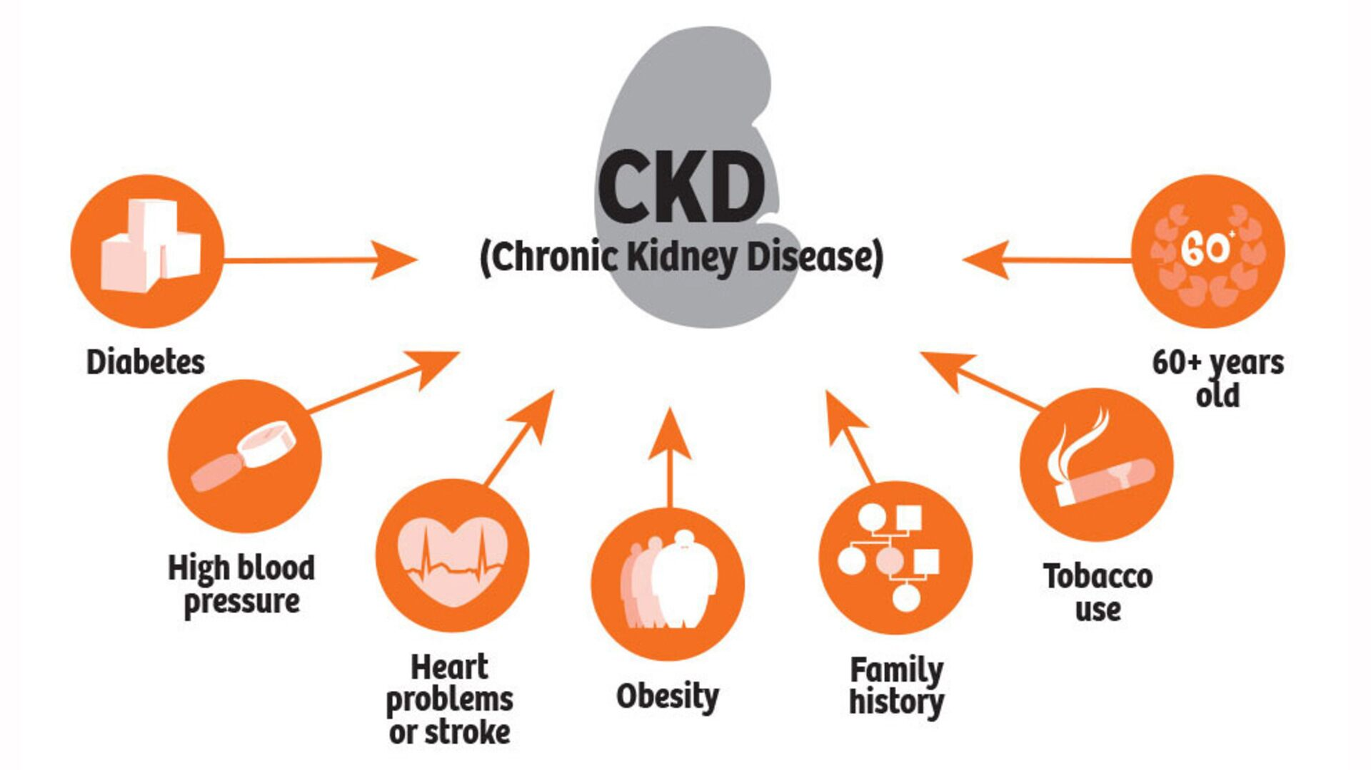
Chronic kidney disease includes conditions that damage your kidneys and decrease their ability to keep you healthy by filtering wastes from your blood. If kidney disease worsens, wastes can build to high levels in your blood and make you feel sick. You may develop complications like:
high blood pressure
anemia (low blood count)
weak bones
poor nutritional health
nerve damage

Slide 4
Are You At Increased Risk for Chronic Kidney Disease? (CKD)
Creatinine is a waste product that comes from the normal wear and tear on muscles of the body. Everyone has creatinine in their bloodstream.
The typical range for serum creatinine is:
For adult men, 0.74 to 1.35 mg/dL (65.4 to 119.3 micromoles/L)
For adult women, 0.59 to 1.04 mg/dL (52.2 to 91.9 micromoles/L)
If it is out of range, the patient should undergo dialysis.
Everyone has experienced the difficulty of receiving varying creatinine results from different hospitals. So, how about a quick CKD test at your fingertips?

Slide 5
Predict if you have CKD.
Keep the records of your medical history.
Refers you the best doctors.
Provides you the location of nearest medical stores.
Emergency contacts.
Overview of the App

Slide 6
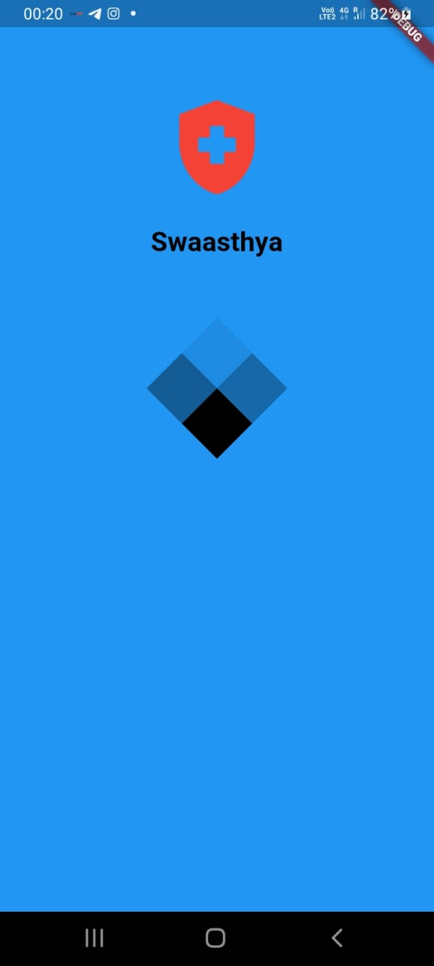
0. Splash Screen

Slide 7
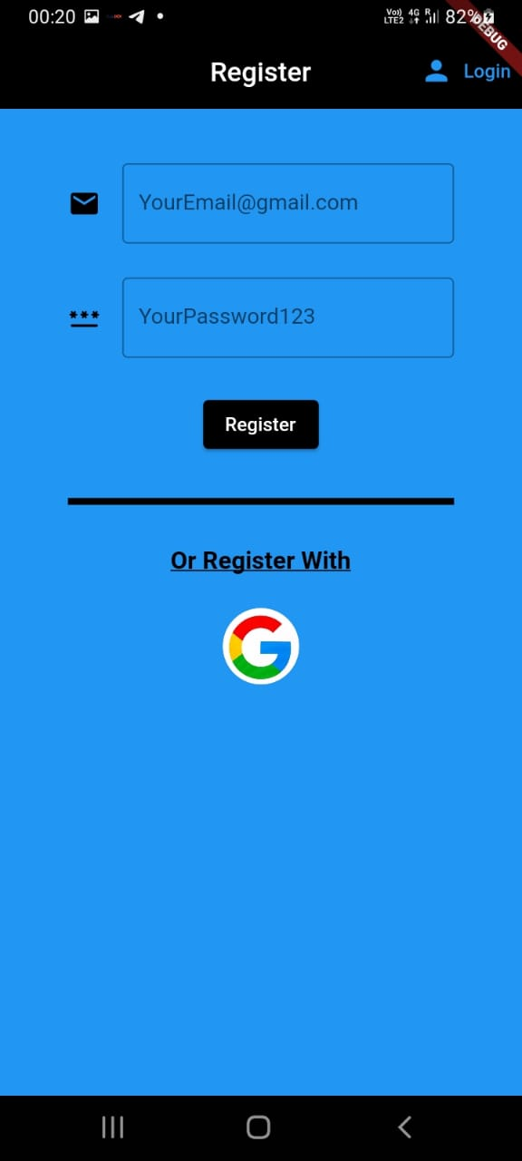
1. Register Page

Slide 8
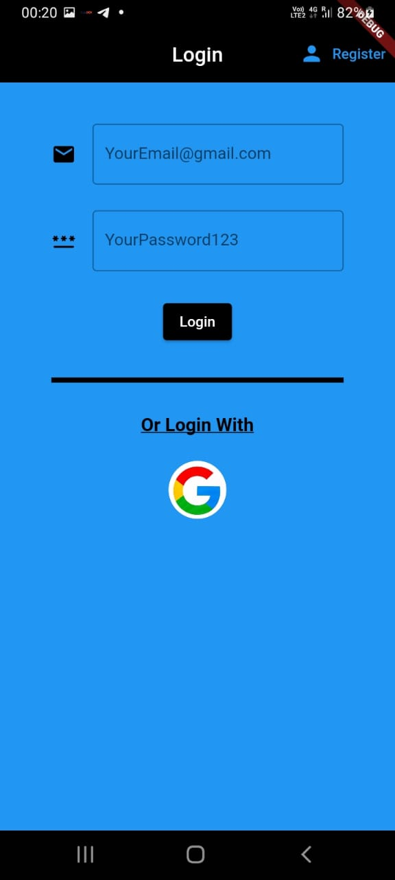
2. Login Page

Slide 9
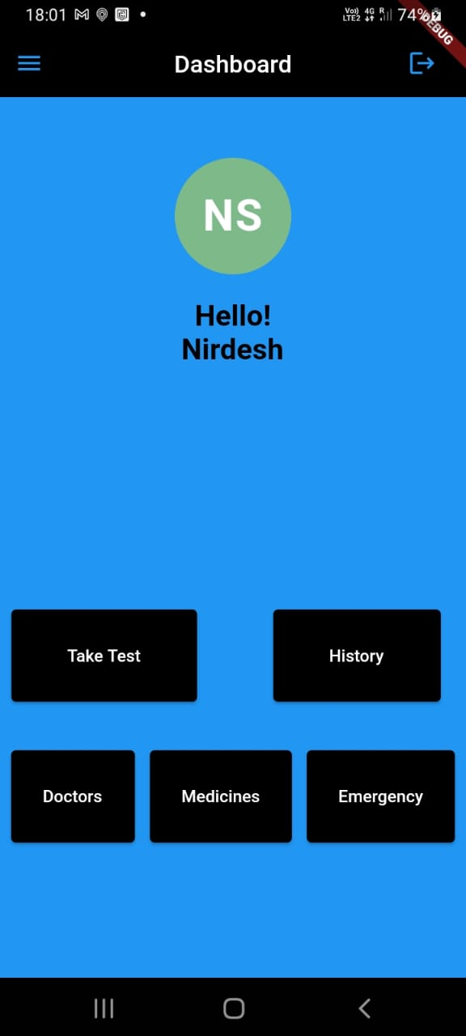
3. Dashboard

Slide 10
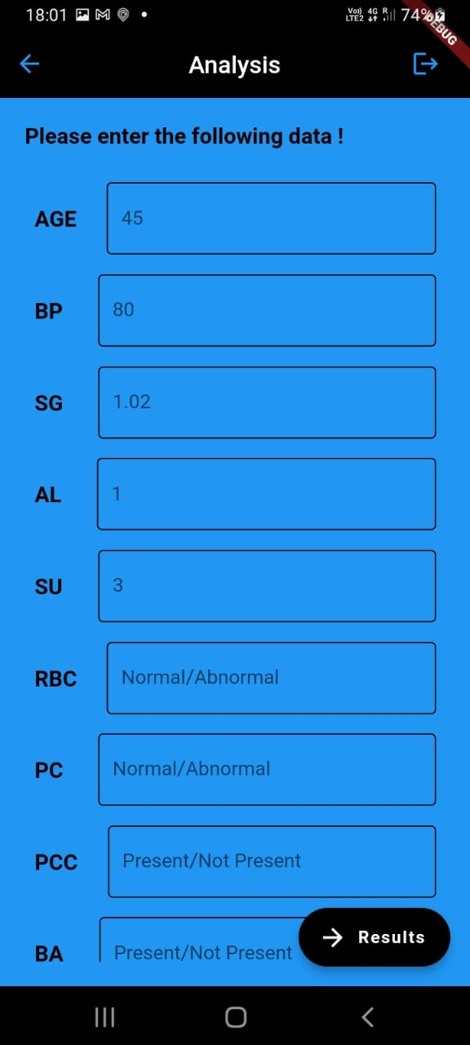
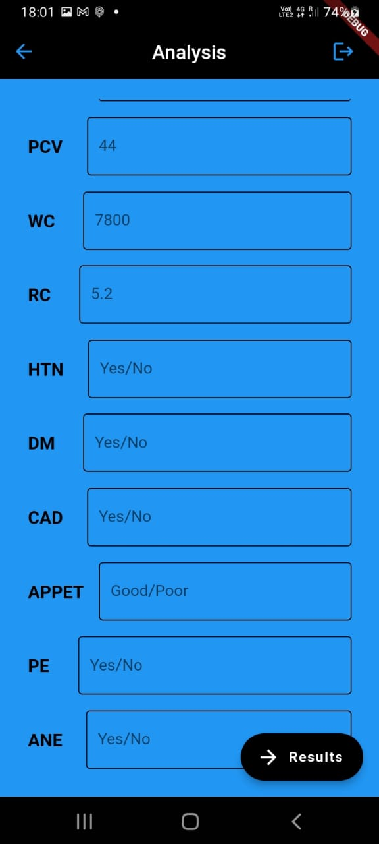
4. Analysis

Slide 11
ML Model
Dataset of CKD.
Splitting the data into trained data (70%) and test data (30%).
Trained the data based on Relu activation function.
Prediction of the CKD based on the data filled by the user.
Usage of tensorflow to deploy into the flutter App.

Slide 12
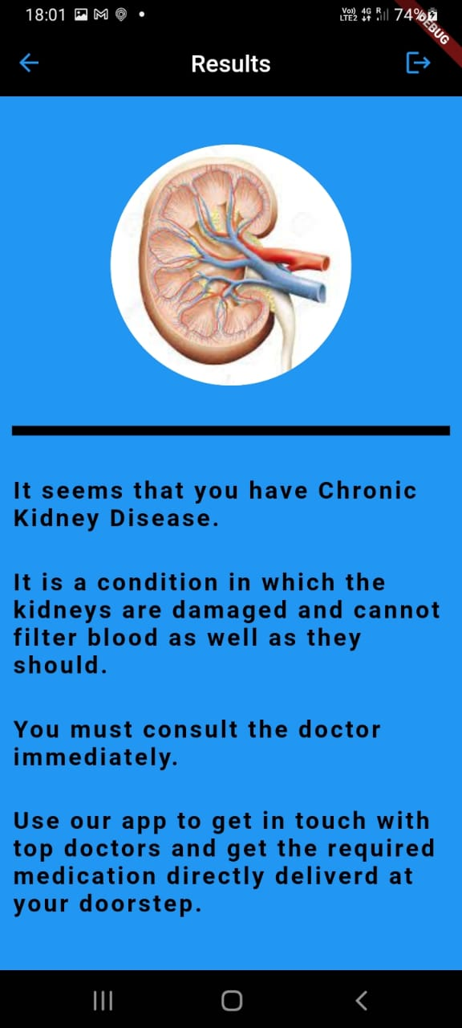
5. Results

Slide 13
References
https://drive.google.com/file/d/14nvAIWrup9dpI7dGpole8ELPzGkaiWar/view?usp=sharing
https://docs.flutter.dev/
https://www.tensorflow.org/
https://www.karger.com/Article/FullText/504622
https://www.journals.elsevier.com/advances-in-chronic-kidney-disease
https://machinelearningmastery.com/rectified-linear-activation-function-for-deep-learning-neural-networks/#:~:text=The%20rectified%20linear%20activation%20function,otherwise%2C%20it%20will%20output%20zero.

Slide 14
Thank You

